Slide 1
Process Management
Instructor: Asst Prof Mobeena Shahzad
BESE 26 (A,B,C)
Fall 2022

Slide 2
Process Concept
Process – a program in execution
process execution must progress in sequential fashion.
No parallel execution of instructions of a single process
Process is the dynamic execution context of a program
An operating system executes a variety of programs that run as a process.
Multiple parts
The program code, also called text section
Current activity including program counter, processor registers
Stack containing temporary data
Function parameters, return addresses, local variables
Data section containing global variables
Heap containing memory dynamically allocated during run time

Slide 3
Process Concept (Cont.)
Program is passive entity stored on disk (executable file); process is active
Program becomes process when an executable file is loaded into memory
Execution of program started via GUI mouse clicks, command line entry of its name, etc.
One program can be several processes
Consider multiple users executing the same program

Slide 4
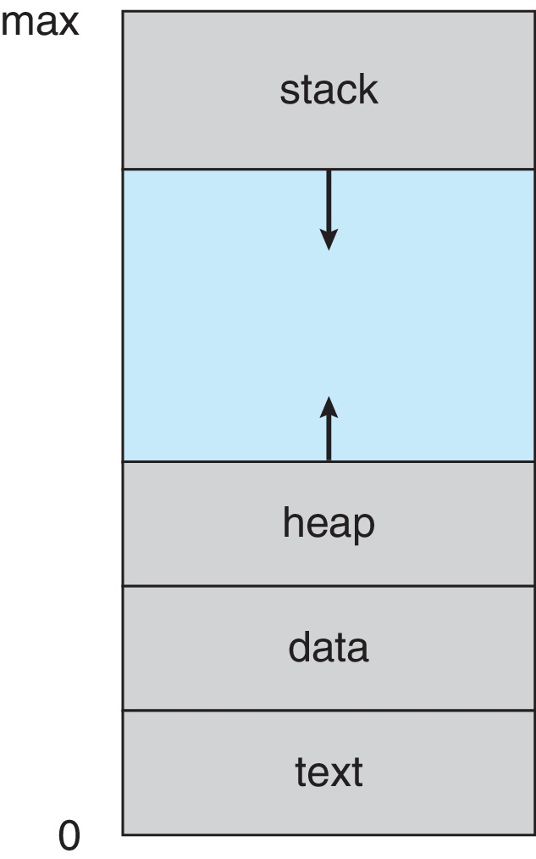
Process in Memory

Slide 5
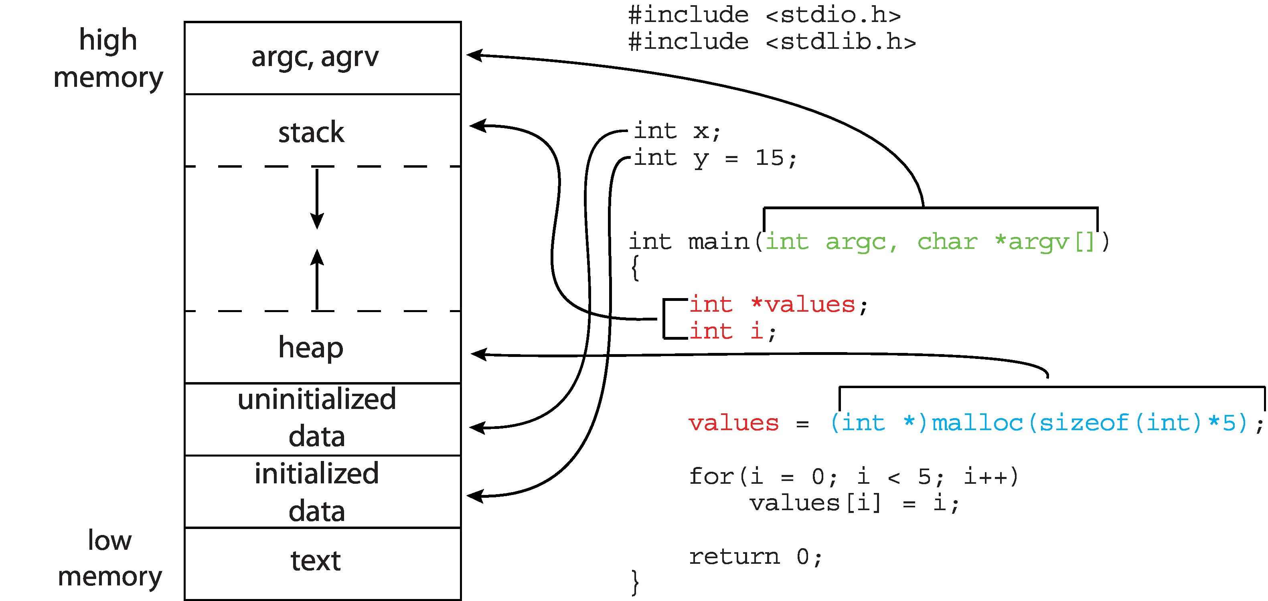
Memory Layout of a C Program

Slide 6
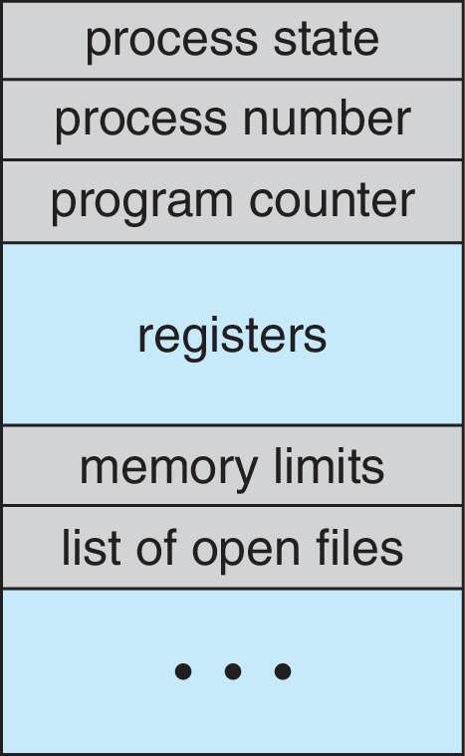
Process Control Block (PCB)
Information associated with each process (also called task control block)
Process state – running, waiting, etc.
Program counter – location of instruction to next execute
CPU registers – contents of all process-centric registers
CPU scheduling information- priorities, scheduling queue pointers
Memory-management information – memory allocated to the process
Accounting information – CPU used, clock time elapsed since start, time limits
I/O status information – I/O devices allocated to process, list of open files

Slide 7
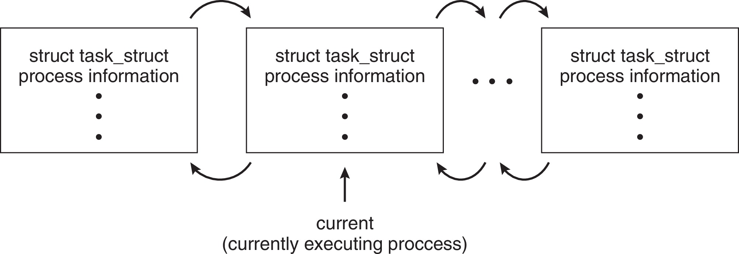
Process Representation in Linux
Represented by the C structure task_struct
pid t_pid; /* process identifier */ long state; /* state of the process */ unsigned int time_slice /* scheduling information */ struct task_struct *parent;/* this process’s parent */ struct list_head children; /* this process’s children */ struct files_struct *files;/* list of open files */ struct mm_struct *mm; /* address space of this process */

Slide 8
Process State
As a process executes, it changes state
New: The process is being created
Running: Instructions are being executed
Waiting: The process is waiting for some event to occur
Ready: The process is waiting to be assigned to a processor
Terminated: The process has finished execution

Slide 9
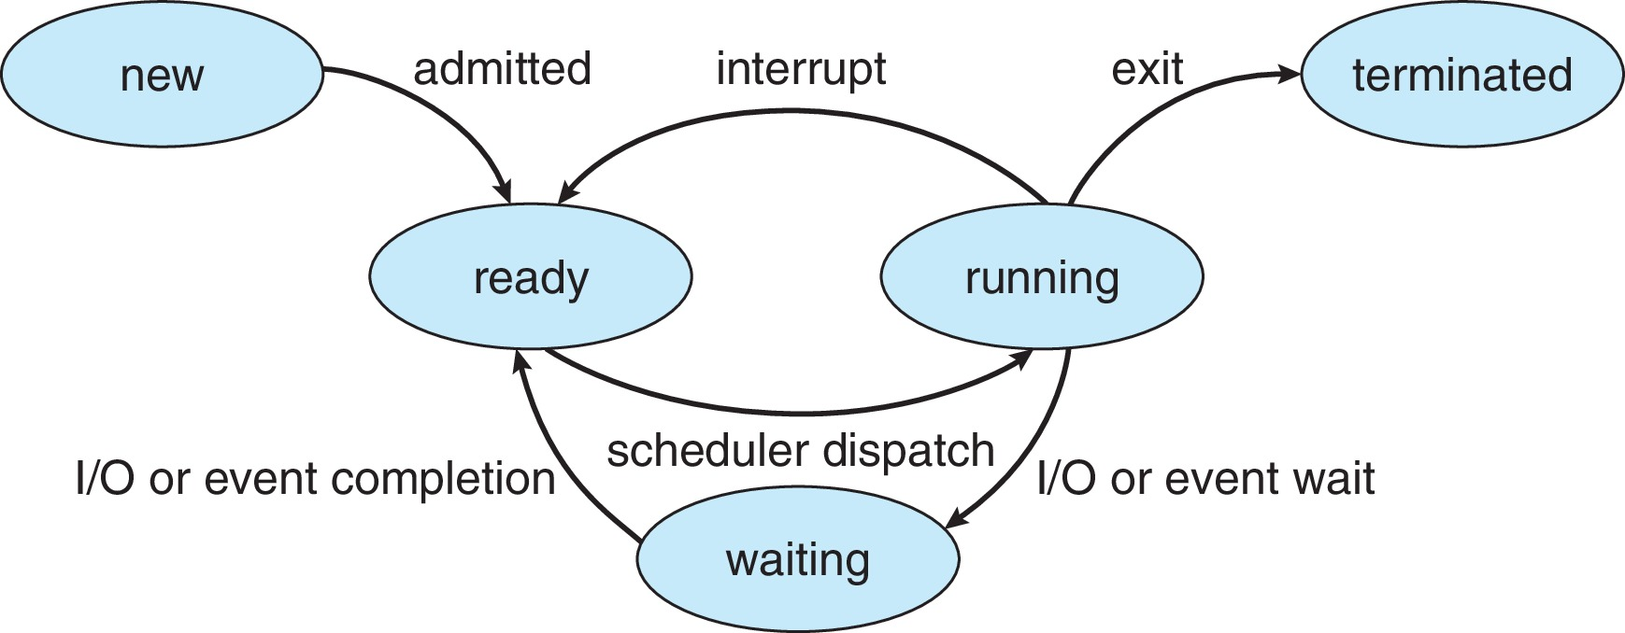
Diagram of Process State

Slide 10
Process Scheduling
Process scheduler selects among available processes for next execution on CPU core
Goal -- Maximize CPU use, quickly switch processes onto CPU core
Maintains scheduling queues of processes
Ready queue – set of all processes residing in main memory, ready and waiting to execute
Wait queues – set of processes waiting for an event (i.e., I/O)
Processes migrate among the various queues

Slide 11
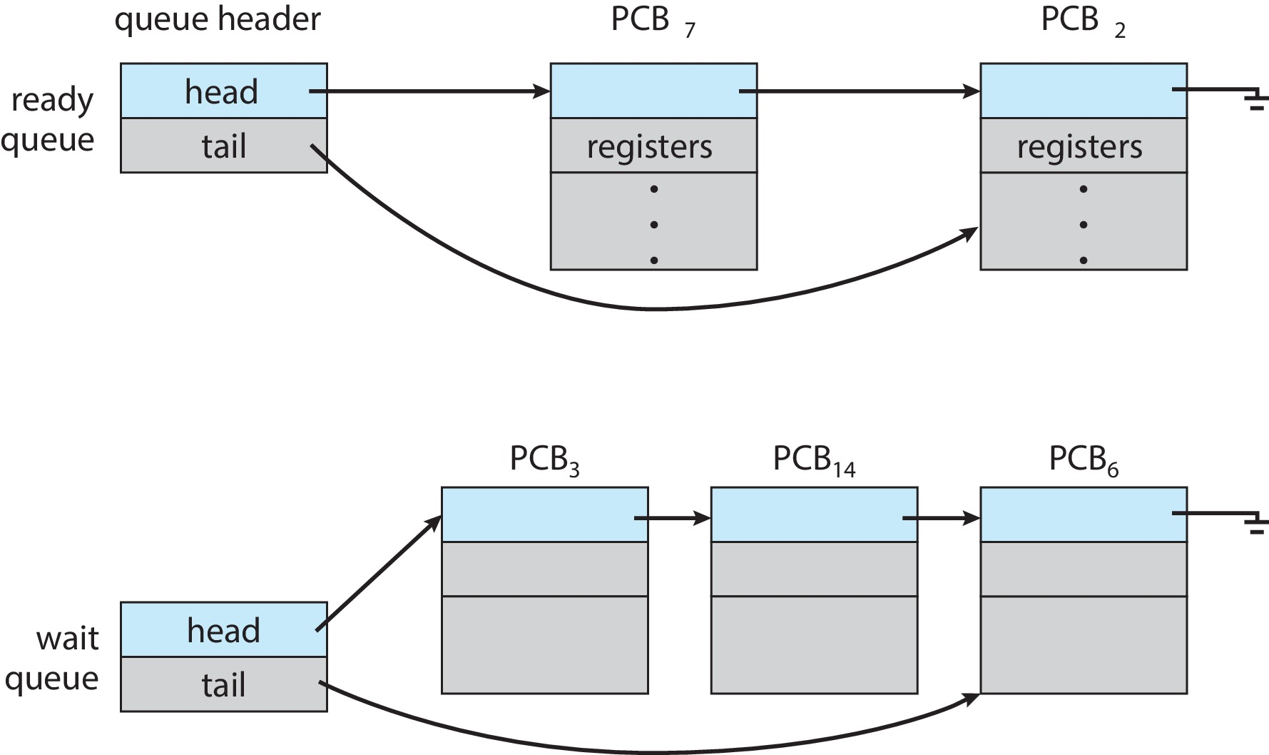
Ready and Wait Queues

Slide 12
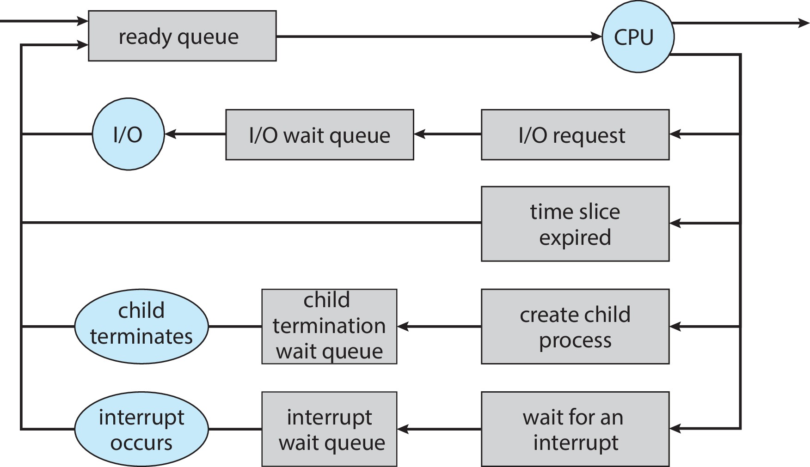
Representation of Process Scheduling

Slide 13
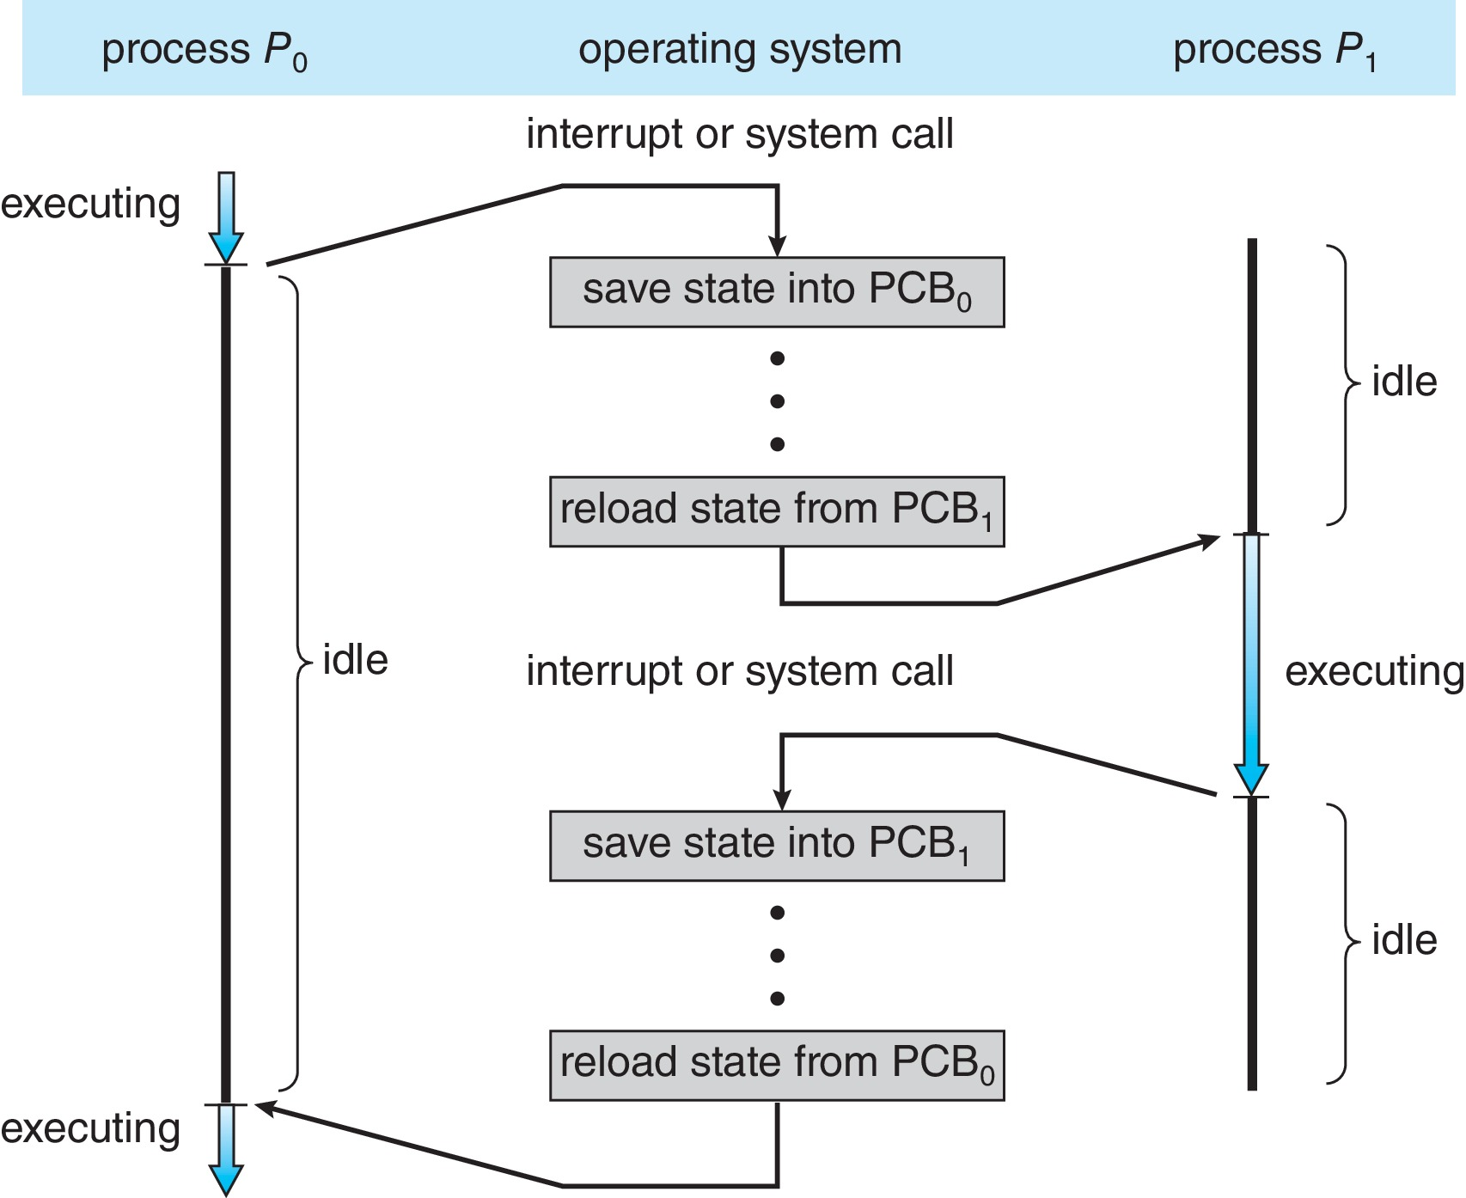
CPU Switch From Process to Process
A context switch occurs when the CPU switches from one process to another.

Slide 14
Context Switch
When CPU switches to another process, the system must save the state of the old process and load the saved state for the new process via a context switch
Context of a process represented in the PCB
Context-switch time is pure overhead; the system does no useful work while switching
The more complex the OS and the PCB ➔ the longer the context switch
Time dependent on hardware support
Some hardware provides multiple sets of registers per CPU ➔ multiple contexts loaded at once

Slide 15
Multitasking in Mobile Systems
Some mobile systems (e.g., early version of iOS) allow only one process to run, others suspended
Due to screen real estate, user interface limits iOS provides for a
Single foreground process- controlled via user interface
Multiple background processes– in memory, running, but not on the display, and with limits
Limits include single, short task, receiving notification of events, specific long-running tasks like audio playback
Android runs foreground and background, with fewer limits
Background process uses a service to perform tasks
Service can keep running even if background process is suspended
Service has no user interface, small memory use

Slide 16
Operations on Processes
System must provide mechanisms for:
Process creation
Process termination

Slide 17
Process Creation
Parent process create children processes, which, in turn create other processes, forming a tree of processes
Generally, process identified and managed via a process identifier (pid)
Resource sharing options
Parent and children share all resources
Children share subset of parent’s resources
Parent and child share no resources
Execution options
Parent and children execute concurrently
Parent waits until children terminate
Address space
Child duplicate of parent
Child has a program loaded into it

Slide 18
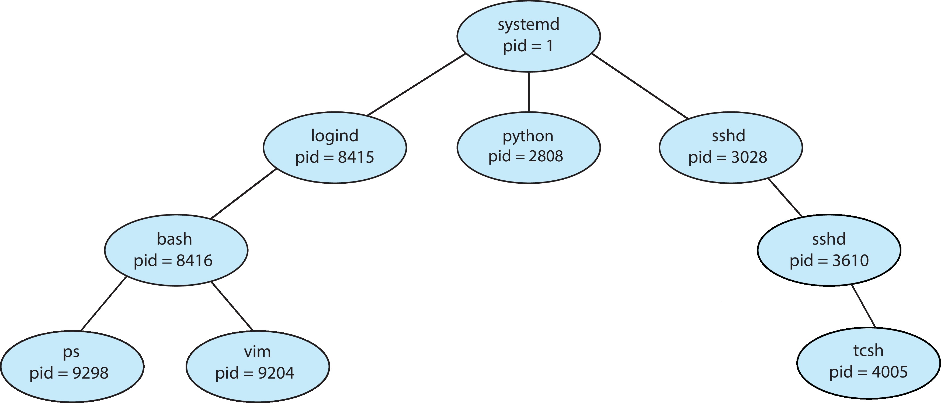
A Tree of Processes in Linux
Notes:
logind → manages user logins
bash → shell
ps → process information/state
vim→ text editor
sshd → SSH server process

Slide 19
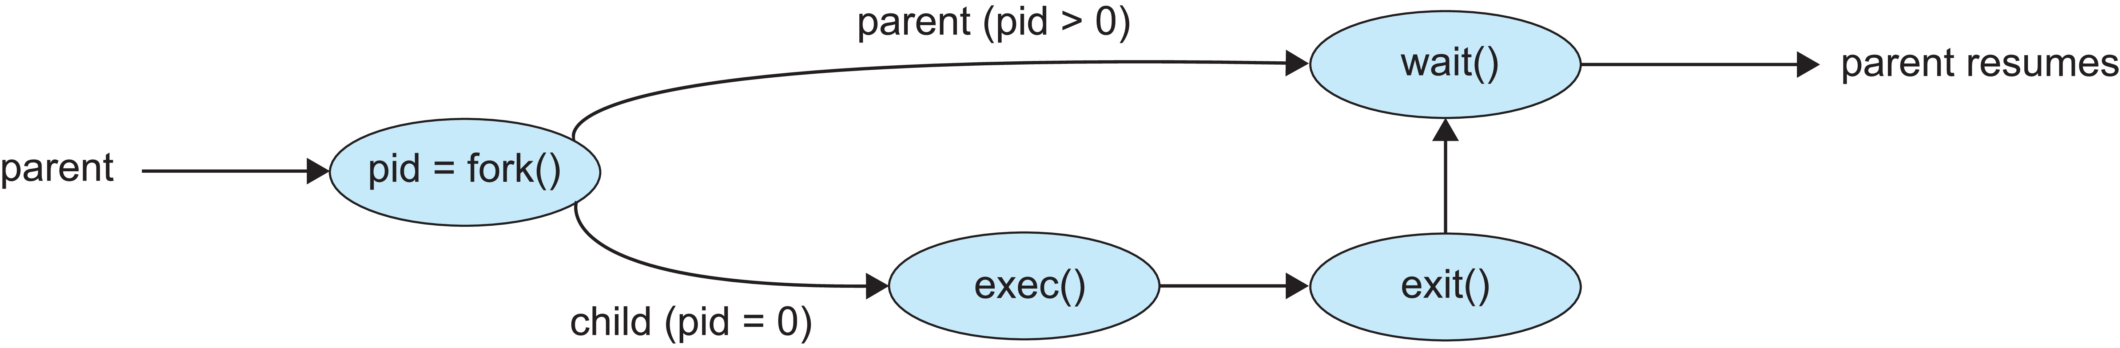
Process Creation
UNIX examples
fork() system call creates new process
exec() system call used after a fork() to replace the process’ memory space with a new program
Parent process calls wait()waiting for the child to terminate

Slide 20
Process Creation: Unix
In Unix, subprocess is created by a call to system routine fork
The variable values and program counter (PC) are copied from the parent to the new child process
The return value of fork is different in the parent and child process
In the parent process, the return value is the child process Id
In the child process, the return value is 0
This is the only difference between the parent and the child process
The parent can wait for the child to terminate by executing wait system call OR the parent can continue to execute
The child often starts a new and different program within itself, via a call to exec

Slide 21
C Program Forking Separate Process
#include <sys/types.h>
#include <studio.h>
#include <unistd.h>
int main()
{
pid_t retValue;
retValue = fork(); /* fork another process */
if (retValue < 0) { /* error occurred */
printf ("Fork Failed");
return 1;
}
else if (retValue == 0) { /* child process */
printf (“Child Process Created");
}
else if (retValue > 0) { /* parent process */
/* parent will wait for the child */
wait (NULL);
printf ("Child Complete");
}
return 0;
}
Child
Parent

Slide 22
C Program Forking Separate Process
int main()
{
pid_t retValue;
retValue = fork(); /* fork another process */
if (retValue < 0) { /* error occurred */
printf ("Fork Failed");
return 1;
}
else if (retValue == 0) { /* child process */
printf (“Child Process Created");
execlp ("/bin/ls", "ls", NULL);
}
else { /* parent process */
/* parent will wait for the child */
wait (NULL);
printf ("Child Complete");
}
return 0;
}

Slide 23
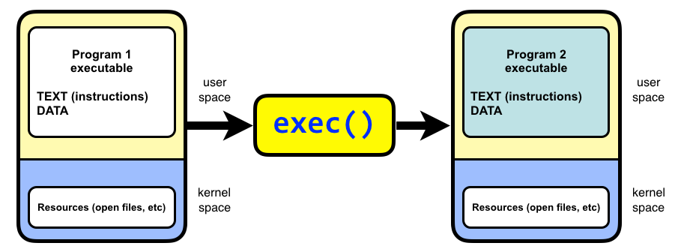

Slide 24
Process Creation – Using fork()
pid_t fork(); -- copy the current process
New process has different pid
Return value from fork(): pid (like an integer)
When > 0:
Running in (original) Parent process
return value is pid of new child
When = 0:
Running in new Child process
When < 0:
Error! Must handle somehow
Running in original process
State of original process duplicated in both Parent and Child!

Slide 25
fork() + exec()
Child
Parent

Slide 26
Example
#include <stdlib.h>
#include <stdio.h>
#include <unistd.h>
#include <sys/types.h>
int main(int argc, char *argv[]) {
pid_t cpid, mypid;
pid_t pid = getpid(); /* get current processes PID */
printf("Parent pid: %d\n", pid);
cpid = fork();
if (cpid > 0) { /* Parent Process */
mypid = getpid();
printf("[%d] parent of [%d]\n", mypid, cpid);
} else if (cpid == 0) { /* Child Process */
mypid = getpid();
printf("[%d] child\n", mypid);
} else {
perror("Fork failed");
}
}

Slide 27
#include <stdlib.h>
#include <stdio.h>
#include <unistd.h>
#include <sys/types.h>
int main(int argc, char *argv[]) {
pid_t cpid, mypid;
pid_t pid = getpid(); /* get current processes PID */
printf("Parent pid: %d\n", pid);
cpid = fork();
if (cpid > 0) { /* Parent Process */
mypid = getpid();
printf("[%d] parent of [%d]\n", mypid, cpid);
} else if (cpid == 0) { /* Child Process */
mypid = getpid();
printf("[%d] child\n", mypid);
} else {
perror("Fork failed");
}
}
Example

Slide 28
#include <stdlib.h>
#include <stdio.h>
#include <unistd.h>
#include <sys/types.h>
int main(int argc, char *argv[]) {
pid_t cpid, mypid;
pid_t pid = getpid(); /* get current processes PID */
printf("Parent pid: %d\n", pid);
cpid = fork();
if (cpid > 0) { /* Parent Process */
mypid = getpid();
printf("[%d] parent of [%d]\n", mypid, cpid);
} else if (cpid == 0) { /* Child Process */
mypid = getpid();
printf("[%d] child\n", mypid);
} else {
perror("Fork failed");
}
}
Example

Slide 29
#include <stdlib.h>
#include <stdio.h>
#include <unistd.h>
#include <sys/types.h>
int main(int argc, char *argv[]) {
pid_t cpid, mypid;
pid_t pid = getpid(); /* get current processes PID */
printf("Parent pid: %d\n", pid);
cpid = fork();
if (cpid > 0) { /* Parent Process */
mypid = getpid();
printf("[%d] parent of [%d]\n", mypid, cpid);
} else if (cpid == 0) { /* Child Process */
mypid = getpid();
printf("[%d] child\n", mypid);
} else {
perror("Fork failed");
}
}
Example

Slide 30
Example 2
int i;
cpid = fork();
if (cpid > 0) {
for (i = 0; i < 5; i++) {
printf("Parent: %d\n", i);
}
} else if (cpid == 0) {
for (i = 0; i > -5; i--) {
printf("Child: %d\n", i);
}
}
What does this print?

Slide 31
Process Creation using WIN32 API
#include <windows.h>
int main( VOID ){
STARTUPINFO si;
PROCESS_INFORMATION pi;
ZeroMemory( &si, sizeof(si) );
si.cb = sizeof(si);
ZeroMemory( &pi, sizeof(pi) ); // Start the child process.
if( !CreateProcess( NULL, // No module name (use command line).
"C:\\WINDOWS\\system32\\mspaint.exe", // Command line.
NULL, // Process handle not inheritable.
NULL, // Thread handle not inheritable.
FALSE, // Set handle inheritance to FALSE.
0, // No creation flags.
NULL, // Use parent's environment block.
NULL, // Use parent's starting directory.
&si, // Pointer to STARTUPINFO structure.
&pi ) // Pointer to PROCESS_INFORMATION structure.
)
{
printf( "CreateProcess failed (%d).\n", GetLastError() );
return -1;
}
WaitForSingleObject( pi.hProcess, INFINITE ); // Wait until child process exits.
CloseHandle( pi.hProcess ); // Close process and thread handles.
CloseHandle( pi.hThread );
}

Slide 32
#include <windows.h>
int main( VOID ){
STARTUPINFO si;
PROCESS_INFORMATION pi;
ZeroMemory( &si, sizeof(si) );
si.cb = sizeof(si);
ZeroMemory( &pi, sizeof(pi) );
BOOL retValue;
retValue = CreateProcess( NULL, "C:\\WINDOWS\\system32\\mspaint.exe", NULL, NULL, FALSE, 0, NULL, NULL, &si, &pi )
if( retValue == 0)
{
printf( "CreateProcess failed (%d).\n", GetLastError() );
return -1;
}
WaitForSingleObject( pi.hProcess, INFINITE ); // Wait until child process exits.
CloseHandle( pi.hProcess ); // Close process and thread handles.
CloseHandle( pi.hThread );
}

Slide 33
Process Termination
Process executes last statement and then asks the operating system to delete it using the exit() system call.
Returns status data from child to parent (via wait())
Process’ resources are deallocated by operating system
Parent may terminate the execution of children processes using the abort() system call. Some reasons for doing so:
Child has exceeded allocated resources
Task assigned to child is no longer required
The parent is exiting, and the operating systems does not allow a child to continue if its parent terminates

Slide 34
Process Termination
Some operating systems do not allow child to exists if its parent has terminated. If a process terminates, then all its children must also be terminated.
cascading termination. All children, grandchildren, etc., are terminated.
The termination is initiated by the operating system.
The parent process may wait for termination of a child process by using the wait()system call. The call returns status information and the pid of the terminated process
pid = wait(&status);
If no parent waiting (did not invoke wait()) process is a zombie
If parent terminated without invoking wait(), process is an orphan

Slide 35
Android Process Importance Hierarchy
Mobile operating systems often have to terminate processes to reclaim system resources such as memory. From most to least important:
Foreground process
Visible process
Service process
Background process
Empty process
Android will begin terminating processes that are least important.

Slide 36

Multi-process Architecture – Chrome Browser
Many web browsers ran as single process (some still do)
If one web site causes trouble, entire browser can hang or crash
Google Chrome Browser is multi-process with 3 different types of processes:
Browser process manages user interface, disk and network I/O
Renderer process renders web pages, deals with HTML, Javascript. A new renderer created for each website opened
Plug-in process for each type of plug-in

Slide 37
Interprocess Communication

Slide 38
Interprocess Communication
Processes within a system may be independent or cooperating
Cooperating process can affect or be affected by other processes, including sharing data
Reasons for cooperating processes:
Information sharing
Computation speedup
Modularity
Convenience
Cooperating processes need interprocess communication (IPC)
Two models of IPC
Shared memory
Message passing

Slide 39
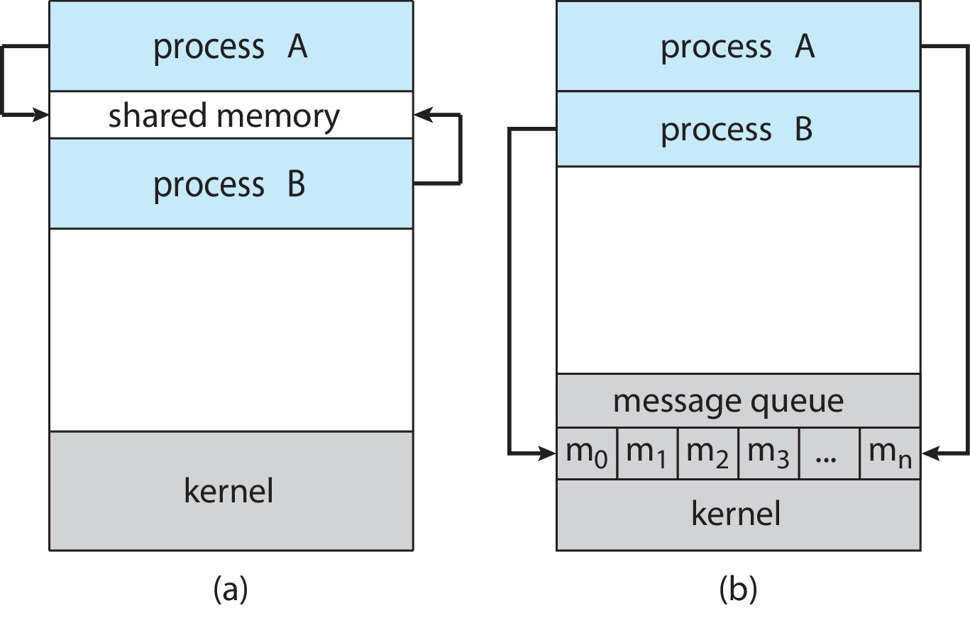
Communications Models
(a) Shared memory. (b) Message passing.

Slide 40
IPC – Shared Memory
An area of memory shared among the processes that wish to communicate
The communication is under the control of the users processes not the operating system.
Major issues is to provide mechanism that will allow the user processes to synchronize their actions when they access shared memory.

Slide 41
Producer-Consumer Problem
Paradigm for cooperating processes:
producer process produces information that is consumed by a consumer process
Two variations:
unbounded-buffer places no practical limit on the size of the buffer:
Producer never waits
Consumer waits if there is no buffer to consume
bounded-buffer assumes that there is a fixed buffer size
Producer must wait if all buffers are full
Consumer waits if there is no buffer to consume

Slide 42
Bounded-Buffer – Shared-Memory Solution
Shared data
#define BUFFER_SIZE 10
typedef struct {
. . .
} item;
item buffer[BUFFER_SIZE];
int in = 0;
int out = 0;
Solution is correct, but can only use BUFFER_SIZE-1 elements

Slide 43
while (true) {
/* Produce an item */
while (( (in+1) % BUFFER SIZE) == out) ; /* do nothing -- no free buffers */
buffer[in] = nextProduced;
in = (in + 1) % BUFFER SIZE;
}
Producer
while (true) {
while (in == out)
; //do nothing -- nothing to consume
// remove an item from the buffer
nextConsumed= buffer[out];
out = (out + 1) % BUFFER SIZE;
}
Consumer

Slide 44
IPC – Message Passing
Processes communicate with each other without resorting to shared variables
IPC facility provides two operations:
send(message)
receive(message)
The message size is either fixed or variable

Slide 45
Message Passing (Cont.)
If processes P and Q wish to communicate, they need to:
Establish a communication link between them
Exchange messages via send/receive
Implementation issues:
How are links established?
Can a link be associated with more than two processes?
How many links can there be between every pair of communicating processes?
What is the capacity of a link?
Is the size of a message that the link can accommodate fixed or variable?
Is a link unidirectional or bi-directional?

Slide 46
Implementation of Communication Link
Physical:
Shared memory
Hardware bus
Network
Logical:
Direct or indirect
Synchronous or asynchronous
Automatic or explicit buffering

Slide 47
Direct Communication
Processes must name each other explicitly:
send (P, message) – send a message to process P
receive(Q, message) – receive a message from process Q
Properties of communication link
Links are established automatically
A link is associated with exactly one pair of communicating processes
Between each pair there exists exactly one link
The link may be unidirectional, but is usually bi-directional

Slide 48
Indirect Communication
Messages are directed and received from mailboxes (also referred to as ports)
Each mailbox has a unique id
Processes can communicate only if they share a mailbox
Properties of communication link
Link established only if processes share a common mailbox
A link may be associated with many processes
Each pair of processes may share several communication links
Link may be unidirectional or bi-directional

Slide 49
Indirect Communication (Cont.)
Operations
Create a new mailbox (port)
Send and receive messages through mailbox
Delete a mailbox
Primitives are defined as:
send(A, message) – send a message to mailbox A
receive(A, message) – receive a message from mailbox A

Slide 50
Indirect Communication (Cont.)
Mailbox sharing
P₁, P₂, and P₃ share mailbox A
P₁, sends; P₂ and P₃ receive
Who gets the message?
Solutions
Allow a link to be associated with at most two processes
Allow only one process at a time to execute a receive operation
Allow the system to select arbitrarily the receiver. Sender is notified who the receiver was.

Slide 51
Synchronization
Message passing may be either blocking or non-blocking
Blocking is considered synchronous
Blocking send -- the sender is blocked until the message is received
Blocking receive -- the receiver is blocked until a message is available
Non-blocking is considered asynchronous
Non-blocking send -- the sender sends the message and continue
Non-blocking receive -- the receiver receives:
A valid message, or
Null message
Different combinations possible

Slide 52
Producer-Consumer: Message Passing
Producer
message next_produced; while (true) { /* produce an item in next_produced */
send(next_produced);
}
Consumer
message next_consumed; while (true) { receive(next_consumed) /* consume the item in next_consumed */ }

Slide 53
Buffering
Queue of messages attached to the link.
Implemented in one of three ways
Zero capacity – no messages are queued on a link. Sender must wait for receiver (rendezvous)
Bounded capacity – finite length of n messages Sender must wait if link full
3. Unbounded capacity – infinite length Sender never waits

Slide 54
End of Lecture 3 “Process Management”
Useful Links:
https://youtu.be/NB5QcYhGY3c
https://youtu.be/C5T59WsrNCU

